Slide 1
Sampling Methods for Estimating Accuracy and Area of Land Cover Change

Slide 2
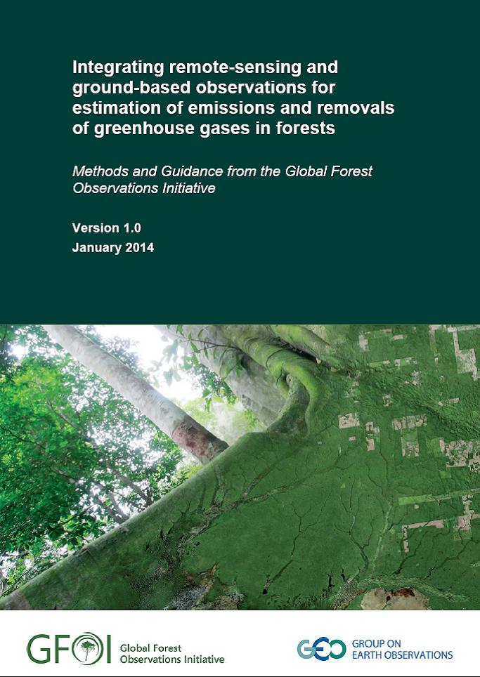

Slide 3
Global Forests Observation Initiative (GFOI)
The intended users of the GFOI Methods and Guidance Document are:
1. Technical negotiators working in the United Nations Framework Convention on Climate Change, who may be interested to see how REDD+ activities can be described and linked to the greenhouse gas methodology of the IPCC, as required by decisions of the Conference of Parties.
2. Those responsible for design decisions in implementing national forest monitoring systems.
3. Experts responsible for making the emissions and removals estimates.

Slide 4
Gain-Loss Method
Changes in carbon pools estimated as product of an area of land and an emission factor
Emission factor describes rate of gain or loss in each carbon pool per unit of land area.
(Area) x (Emission factor)
Area of deforestation (conversion of Forest Land to another land category)

Slide 5
Research Focus
Estimating area using remotely sensed data
  Status of land cover
  Change in land cover (deforestation, degradation)
Combine information from maps (remote sensing) with reference data (remote sensing in some cases) to estimate accuracy and area
Goal: reduce uncertainty associated with sample-based estimates of accuracy and area

Slide 6
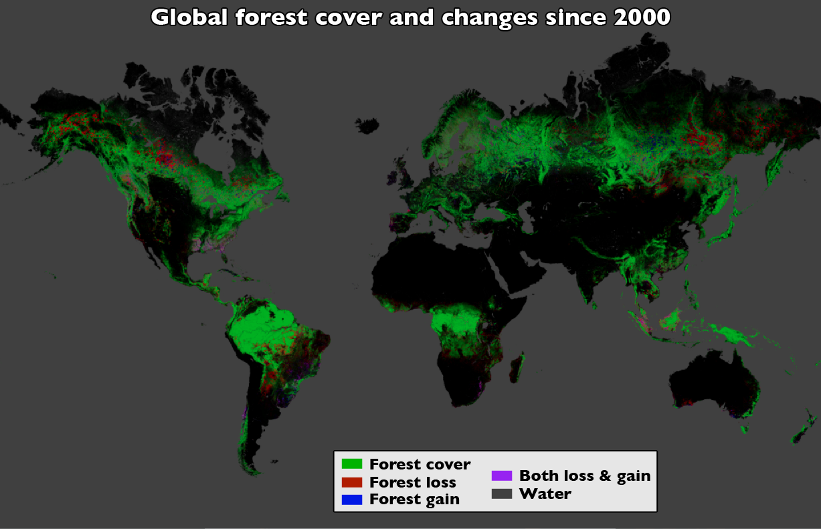
Map of Forest Cover and Loss (Hansen et al. 2013)
Notes:
Start with a map of forest cover loss

Slide 7
Terminology
Reference condition: best assessment of true land cover or change condition at a given location
  Landsat
  RapidEye
  Ground visit (e.g., National Forest Inventory)
Accuracy: the degree to which the map corresponds to the reference condition
Notes:
DEFINITIONS. Standard assumption that there is no “ground truth”

Slide 8
Descriptive Results of Accuracy Assessment: Error Matrix (% of area)
 |  | Reference
Map Class | Forest Loss | Stable Forest | Stable NonFor | Total
Forest Loss | 1.2 | 0.0 | 0.04 | 1.3
Stable Forest | 0.6 | 59.5 | 3.8 | 63.9
Stable NonFor | 0.7 | 0.3 | 33.7 | 34.7
Total | 2.6 | 59.8 | 37.6 | 100.0
Notes:
Important stand alone descriptive information.

Slide 9
Accuracy Assessment and Area Estimation
Reference condition too costly to obtain everywhere – must sample
Sample of reference condition simultaneously provides data to estimate area and assess accuracy
Goal is to identify sampling design and analysis options that reduce uncertainty (standard error) of the estimates

Slide 10
Approach to Area Estimation
Area estimates are based on a sample and the reference condition (highest quality data)
Complete coverage maps provide information to reduce standard errors of estimates
Identify and develop effective ways to combine sample and map information

Slide 11
Application: Estimating Forest Cover Loss in Peru
Landsat-derived forest cover loss from 2000-2011 (Potapov et al. – in review)
Reference condition based on RapidEye (2011)
  Estimate accuracy of loss map
  Estimate area of forest loss
Limited funds for RapidEye purchase
Statistically rigorous but cost effective approach to estimate accuracy and area?

Slide 12
Sampling Design
Stratified two-stage cluster sampling
First stage
  12 km x 12 km cluster (RapidEye)
  Clusters stratified by low and high gross forest cover loss (Landsat map for stratification)
  30 clusters sampled
Second stage
  100 pixels selected within each cluster

Slide 13
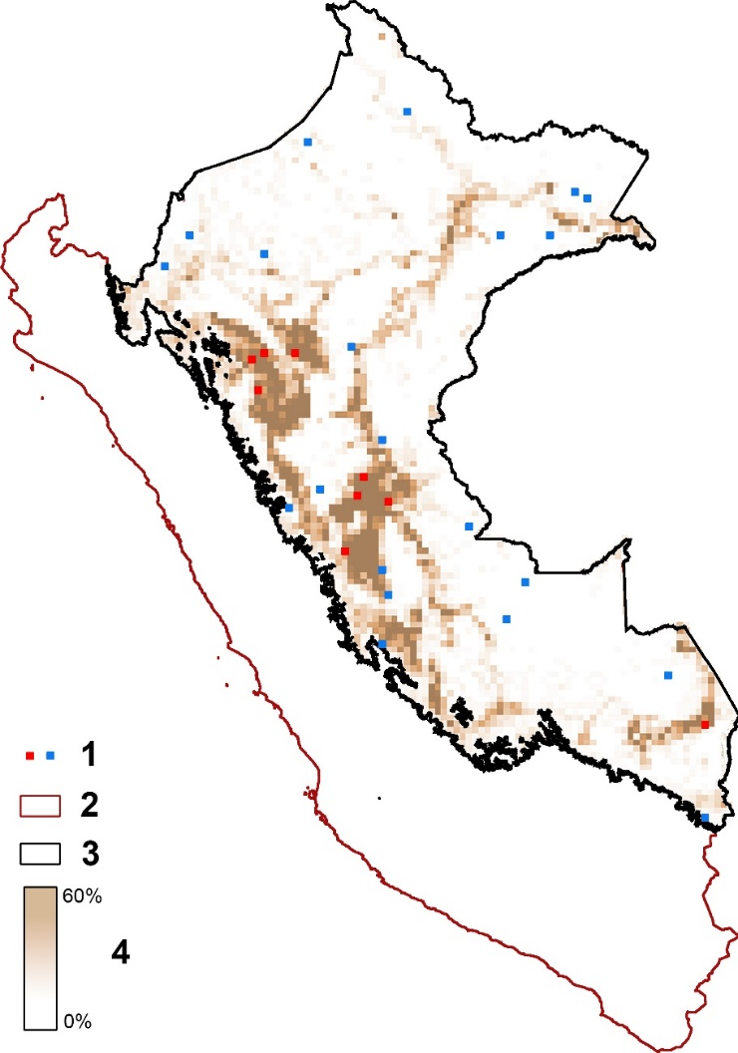
First-Stage Stratified Random Sampling Design for Peru (12 km x 12 km clusters)
Red blocks: high-change stratum
Blue blocks: low-change stratum
Shading: gross forest cover loss percent per 12×12 km block of sampling grid

Slide 14
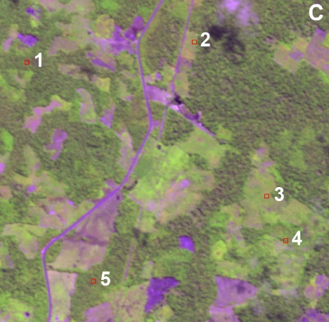
Second-Stage Sample of Pixels within Sampled Cluster (RapidEye)

Slide 15
Results for Peru
Sample-based estimate of forest cover loss for 2000-2011 was 2.44% (% of all area)
Standard error using estimator that incorporates Landsat change map information was 0.16%
Standard error not using map was 0.60%
Forest loss map substantially reduces uncertainty of area estimate

Slide 16
Options for Area Estimators
Direct (map not used)
Model-assisted (use map)
  Difference estimator
  Poststratified estimator
All yield unbiased estimators of area
Estimators vary in precision (standard error)

Slide 17
Ongoing Research: Choosing among Area Estimators
Poststratified estimator generally has smallest standard error
Many clusters have no sample pixels mapped as disturbed (100 pixels sampled per cluster)
  Per-cluster poststratified estimator will be biased
  Difference estimator still viable but standard error may increase relative to using no map data
Evaluate still other alternative estimators

Slide 18
Use of Auxiliary Data to Estimate Area from Remote Sensing
(with John Lombardi, M.S. student at SUNY ESF)

Slide 19
Application
Quantifying area of gross forest cover loss from 2000-2005 (Hansen et al. 2010)
Areal sampling unit: 20 km x 20 km
Y = forest loss determined from Landsat (sample)
X = forest loss determined from MODIS (complete coverage)
FAO Forest Resource Assessment uses similar approach
Notes:
I’ll use work by Hansen et al. as the prototype application to motivate the problem. Forest loss based on sample of Landsat imagery, MODIS complete coverage is AUXILIARY
VARIABLE.

Slide 20
Areal Sampling Unit
Notes:
VISUAL to application, AREAL sampling unit looks like right interpreted from imagery on left (this is just an example using cover)

Slide 21
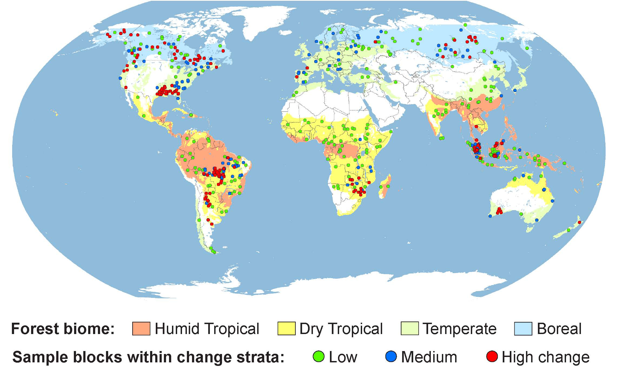
Notes:
Sampling design. 4 biomes BOREAL easiest to see. Low medium high strata from MODIS.

Slide 22
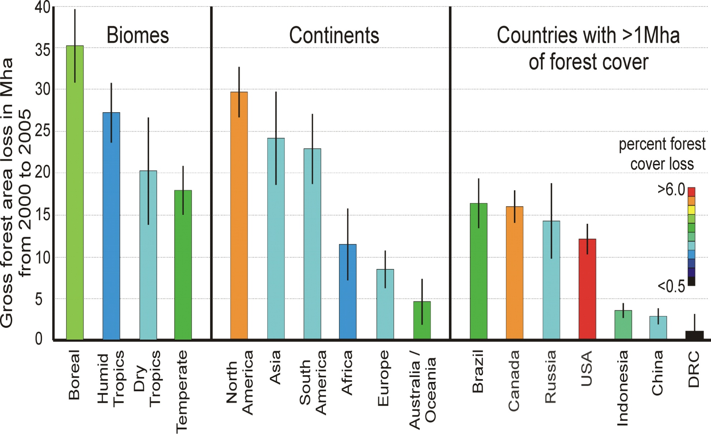
Global Summary: Estimated Gross Forest Cover Loss Mha (±2 SEs)
Notes:
Results (estimates): Area or % of area gross forest cover loss 00-05 by BIOME, CONTINENT, COUNTRY (keep this up for long enough)

Slide 23
General Setting
Estimate area of forest cover loss
Spatial (areal) sampling unit
Y=best assessment of ground condition
  Available only for the sampled units
X=auxiliary variable associated with Y
  Available for the entire target region
Example 1: Y=Landsat, X=MODIS
Example 2: Y=RapidEye, X=Landsat
Notes:
Y is the best available data but you can’t get Y complete coverage, sampling needed.

Slide 24
Options for Use of Auxiliary Variable in a Sampling Strategy
Sampling Strategy = Sampling Design + Estimator
Assume a single auxiliary variable
Options:
  Sampling design (stratification)
  Estimator
  Both design and estimator
Notes:
What is the BEST use of AUX variable?

Slide 25
Stratum Boundaries for Optimal Allocation: Continuous Auxiliary
Dalenius-Hodges (1959, J Amer Stat Assoc)
Geometric (Gunning and Hornung, 2004, Survey Methodology)
Kozak (2004, Statistics in Transition)
R program to implement stratification options
  Baillargeon & Rivest (2011, Survey Methodology)
Model-based stratification
Notes:
Many others

Slide 26
Sampling Strategies Defined by Use of Single Auxiliary Variable
Auxiliary Information | Estimator NO | Estimator YES
Design NO | Simple random sampling | Simple random with regression estimator
Design YES | Stratified random sampling Dalenius-Hodges Kozak Geometric Model-based | Stratified random with separate regression estimator
Notes:
Four general strategies in a 2x2 matrix. SRS as baseline.

Slide 27
Notes:
2x2 matrix of strategies. SRS baseline, SRE and DH about same, using X in both design and estimator produces small decline in RegDH, RegMB1

Slide 28
Excel Sample Allocation Calculator for Accuracy and Area Estimation
Stratified sampling often used for estimating accuracy and area of forest loss (change)
Excel calculator provides optimal sample size allocation to strata to minimize sum of variances of three estimates
  User’s accuracy of change
  Producer’s accuracy of change
  Area of reference change

Slide 29
Summary: Estimating Area and Map Accuracy
Research focuses on an assortment of sampling design and analysis issues
Combine sample of reference condition with maps to reduce standard errors of estimates of accuracy and area
Limited scope for assessment of uncertainty: variation attributable to sampling

